Slide 1
COS 701 – H001
FALL 2022
Final Project
Rachel Prather

Slide 2

Outline
Overview of Problem
Methodology
Discoveries
Results and Questions

Slide 3

The Traveling Salesman Problem
In this problem, we are a salesman who must visit several European cities. However, the budget is limited. Thus, the trip needs to be completed so that the total distance traveled is minimal to reduce the overall cost. We need to visit the cities of London, Amsterdam, Paris, Rome, Prague, Zurich, Berlin, Vienna, Copenhagen, Brussels, and Lisbon.
We will also examine the cases in which Madrid is added to this list and what happens if we fix our starting location to London.

Slide 4

One thing to notice in this situation is that we are starting with 11 cities. Thus, the total number of possible routes is 11! Then, when adding in Madrid, this number climbs to 12!
However, before starting, the distance matrices are required.

Slide 5
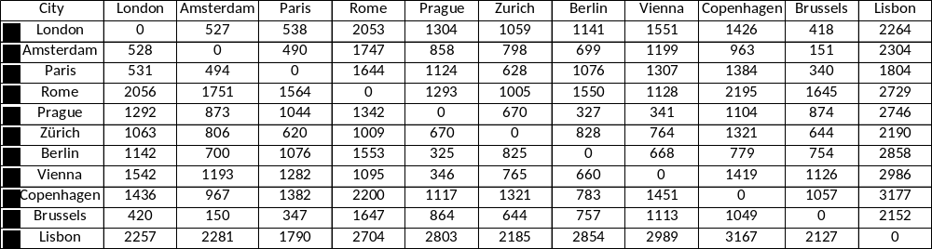
Distance Matrix without Madird
Distance matrix created using data from Google Maps. During the distance calculations, I avoided tolls but still included ferries in the driving directions.

Slide 6
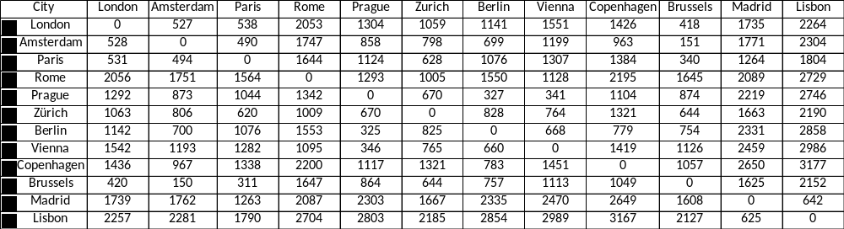
Distance Matrix with Madrid
After obtaining a permutation matrix for the different possible routes, we use these routes to find our minimal distance using the distance matrices.

Slide 7
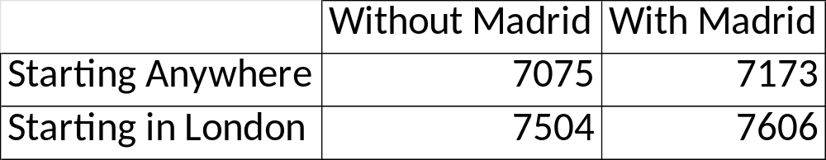
ThE Minimal Distances
Here, we can start to make some observations.
  First, when the starting city does not matter, the distance traveled without including Madrid is 100km less.
  When you make London your starting city, you can see that the distance traveled increased by about 500km for either case.
  If there is a choice, it might be wise to avoid starting in London to keep our costs down
Note: This distances calculated do not include return trips to the starting cities

Slide 8
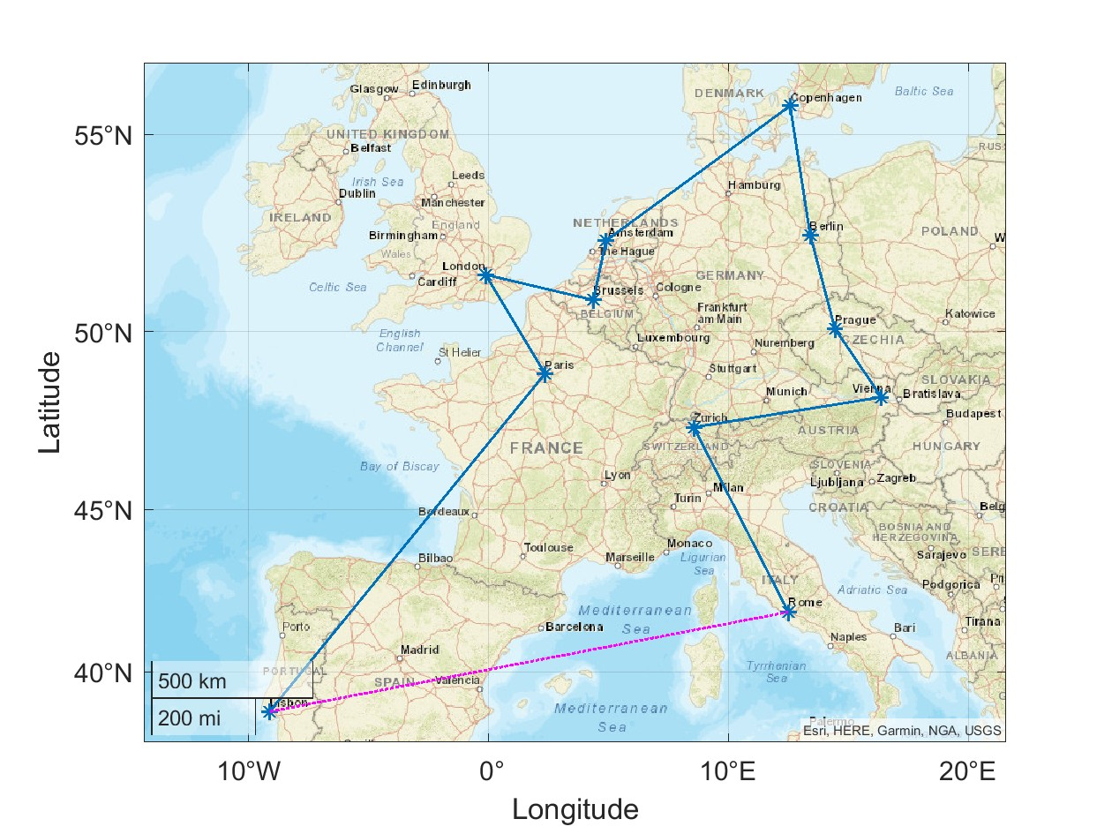

The Routes without Madrid
Starting in Lisbon and ending in Rome
Starting in London and in Lisbon
The purple line marks a path back to the starting city

Slide 9
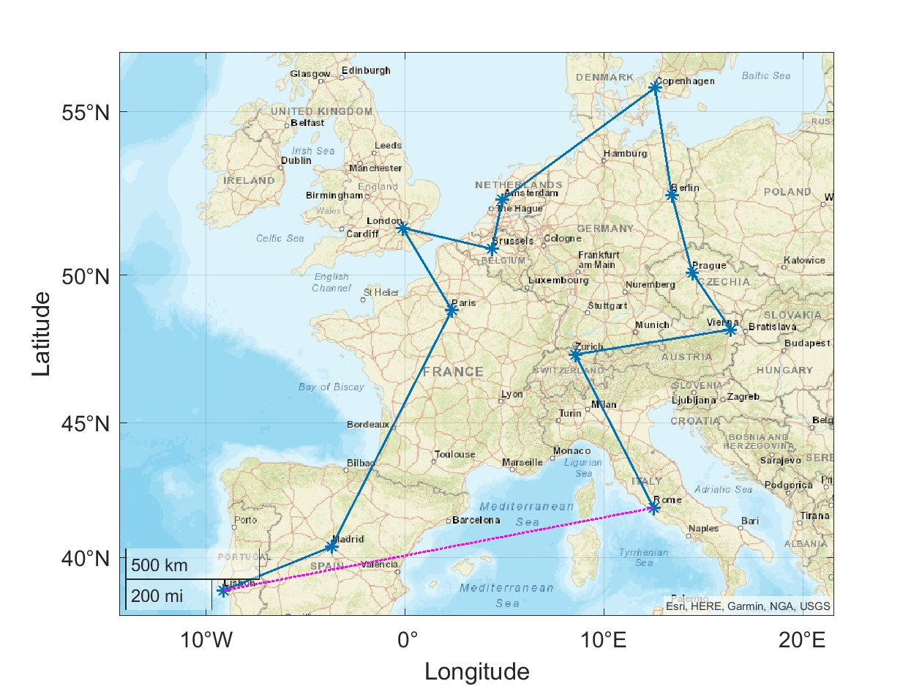

The Routes with Madrid
Starting in Lisbon and ending in Rome
Starting in London and in Lisbon
The purple line marks a path back to the starting city

Slide 10



The Cost
When calculating the overall cost, some assumptions will be made:
  The petrol prices are estimated to be 2 Euro/per liter
  A hotel will cost 100 Euro a night, and we will be staying in each city for two nights
  A small rental car, in this case, a manual Hyundai i10, will cost no more than 750 Euros for unlimited mileage for the trip and will get 20 km/l.

Slide 11
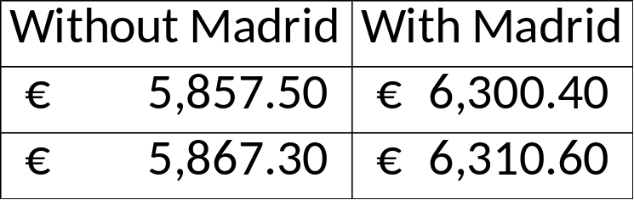
The Cost (continued)
Looking at the cost table displayed, we can see only about a 10 Euro difference when selecting whether we start in London or now.
  However, with the addition of Madrid, the difference in cost is about 500 Euro in either case.
However, it should be noted that this cost estimate does not include any possible ferries that our trip might include.

Slide 12




Thank you
Rachel Prather
Questions?

